Slide 1

Internet of Things
Concepts of communication wireless and electronic
Mehdi Rasti
Amirkabir University of Technology

Slide 2

What this chapter is not?
Detail of electronic
Analysis of electrical circuits
Detail of Signal and Protocol in wireless network
The Importance of Electronics and Wireless Communication and Its Role in IoT

Slide 3
TABLE OF CONTENTS
01 Electronics
02 Basic electrical quantities
03 Analysis of Single-Board Computers for IoT
04 Background on wireless PHY layer
05 System design (under power viewpoint)

Slide 4
01 Electronics

Slide 5
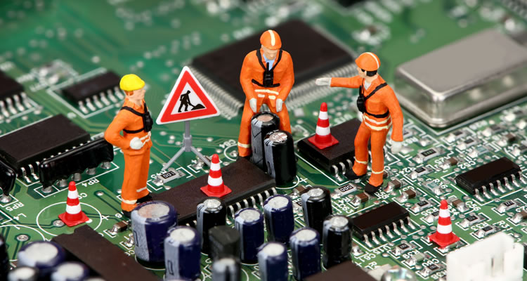
Introduction
They store your money. They monitor your heartbeat. They carry the sound of your voice into other people's homes. They bring airplanes into land and guide cars safely to their destination—they even fire off the airbags if we get into trouble. It's amazing to think just how many things "they" actually do. "They" are electrons: tiny particles within atoms that march around defined paths known as circuits carrying electrical energy. One of the greatest things people learned to do in the 20th century was to use electrons to control machines and process information. The electronics revolution, as this is known, accelerated the computer revolution and both these things have transformed many areas of our lives.
* https://www.explainthatstuff.com/electronics.html, Chris Woodford,November 18, 2018

Slide 6
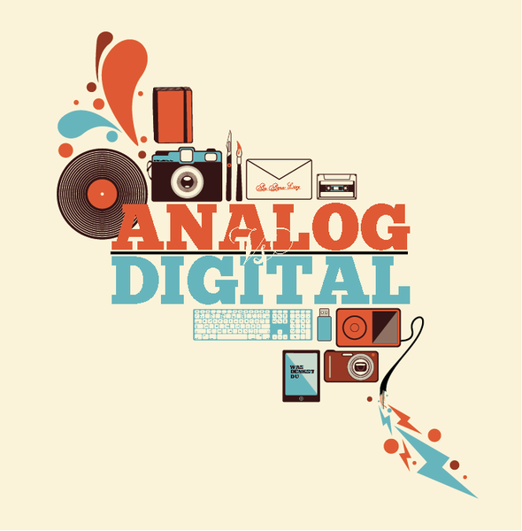
Analog and digital electronics
Electronic equipment generally works on information in either analog or digital format.
In an old-fashioned transistor radio, broadcast signals enter the radio's circuitry via the antenna sticking out of the case.
But in a modern digital radio, things happen in a different way.
It's a very different way of processing information and it has both advantages and disadvantages.
* https://www.explainthatstuff.com/electronics.html, Chris Woodford,November 18, 2018
Notes:
There are two very different ways of storing information—known as analog and digital. It sounds like quite an abstract idea, but it's really very simple. Suppose you take an old-fashioned photograph of someone with a film camera. The camera captures light streaming in through the shutter at the front as a pattern of light and dark areas on chemically treated plastic. The scene you're photographing is converted into a kind of instant, chemical painting—an "analogy" of what you're looking at. That's why we say this is an analog way of storing information. But if you take a photograph of exactly the same scene with a digital camera, the camera stores a very different record. Instead of saving a recognizable pattern of light and dark, it converts the light and dark areas into numbers and stores those instead. Storing a numerical, coded version of something is known as digital.
Electronic equipment generally works on information in either analog or digital format. In an old-fashioned transistor radio, broadcast signals enter the radio's circuitry via the antenna sticking out of the case. These are analog signals: they are radio waves, traveling through the air from a distant radio transmitter, that vibrate up and down in a pattern that corresponds exactly to the words and music they carry. So loud rock music means bigger signals than quiet classical music. The radio keeps the signals in analog form as it receives them, boosts them, and turns them back into sounds you can hear. But in a modern digital radio, things happen in a different way. First, the signals travel in digital format—as coded numbers. When they arrive at your radio, the numbers are converted back into sound signals. It's a very different way of processing information and it has both advantages and disadvantages. Generally, most modern forms of electronic equipment (including computers, cell phones, digital cameras, digital radios, hearing aids, and televisions) use digital electronics.

Slide 7
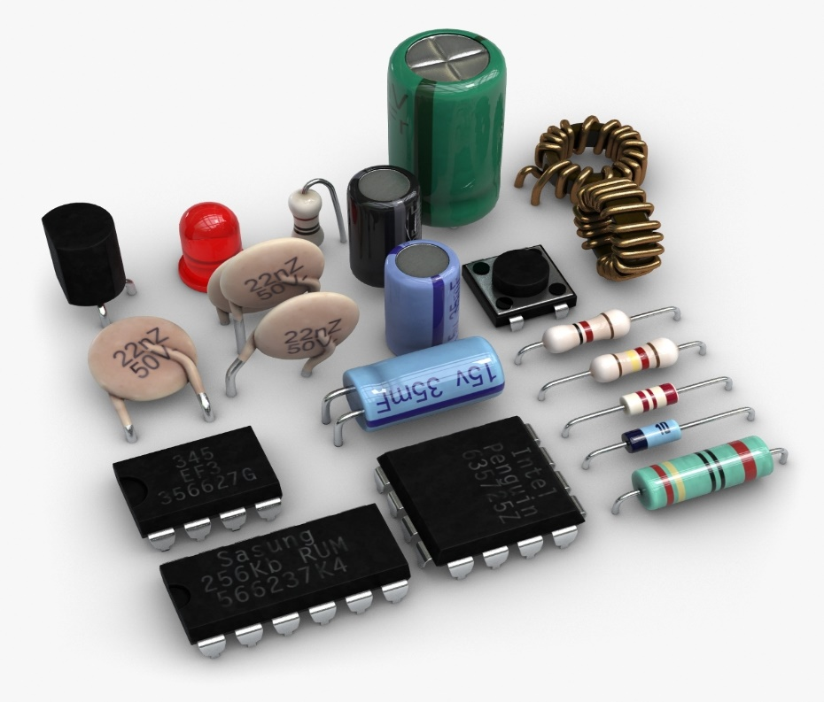
Electronic components
The circuits inside pieces of electronic equipment are a bit like cities too
they're components are linked together by cables or printed metal connections (similar to streets).
electronic circuits are built up from a small number of standard components.
you can put these components together in an infinite number of different places so they do an infinite number of different jobs.
* https://www.explainthatstuff.com/electronics.html, Chris Woodford,November 18, 2018
Notes:
If you've ever looked down on a city from a skyscraper window, you'll have marveled at all the tiny little buildings beneath you and the streets linking them together in all sorts of intricate ways. Every building has a function and the streets, which allow people to travel from one part of a city to another or visit different buildings in turn, make all the buildings work together. The collection of buildings, the way they're arranged, and the many connections between them is what makes a vibrant city so much more than the sum of its individual parts.
The circuits inside pieces of electronic equipment are a bit like cities too: they're packed with components (similar to buildings) that do different jobs and the components are linked together by cables or printed metal connections (similar to streets). Unlike in a city, where virtually every building is unique and even two supposedly identical homes or office blocks may be subtly different, electronic circuits are built up from a small number of standard components. But, just like LEGO®, you can put these components together in an infinite number of different places so they do an infinite number of different jobs.

Slide 8
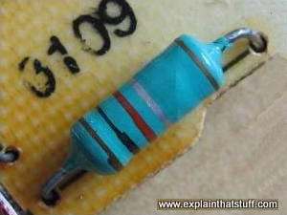
Resistors
These are the simplest components and many different shapes and sizes in any circuit.
Their job is to restrict the flow of electrons and reduce the current or voltage flowing by converting electrical energy into heat.
Variable resistors (also known as potentiometers) have a dial control on them so they change the amount of resistance when you turn them.
* https://www.explainthatstuff.com/electronics.html, Chris Woodford,November 18, 2018
Notes:
These are the simplest components in any circuit. Their job is to restrict the flow of electrons and reduce the current or voltage flowing by converting electrical energy into heat. Resistors come in many different shapes and sizes. Variable resistors (also known as potentiometers) have a dial control on them so they change the amount of resistance when you turn them. Volume controls in audio equipment use variable resistors like these.

Slide 9
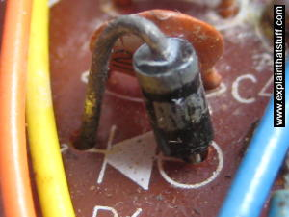
Diodes
The electronic equivalents of one-way streets.
diodes allow an electric current to flow through them in only one direction.
They are also known as rectifiers.
Diodes can be used to change alternating currents (ones flowing back and forth round a circuit, constantly swapping direction) into direct currents (ones that always flow in the same direction).
* https://www.explainthatstuff.com/electronics.html, Chris Woodford,November 18, 2018
Notes:
The electronic equivalents of one-way streets, diodes allow an electric current to flow through them in only one direction. They are also known as rectifiers. Diodes can be used to change alternating currents (ones flowing back and forth round a circuit, constantly swapping direction) into direct currents (ones that always flow in the same direction).

Slide 10
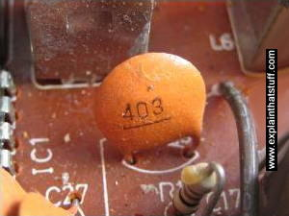
Capacitors
These relatively simple components consist of two pieces of conducting material (such as metal) separated by a non-conducting (insulating) material called a dielectric.
They are often used as timing devices, but they can transform electrical currents in other ways too.
In a radio, one of the most important jobs, tuning into the station you want to listen to, is done by a capacitor.
* https://www.explainthatstuff.com/electronics.html, Chris Woodford,November 18, 2018
Notes:
These relatively simple components consist of two pieces of conducting material (such as metal) separated by a non-conducting (insulating) material called a dielectric. They are often used as timing devices, but they can transform electrical currents in other ways too. In a radio, one of the most important jobs, tuning into the station you want to listen to, is done by a capacitor.

Slide 11
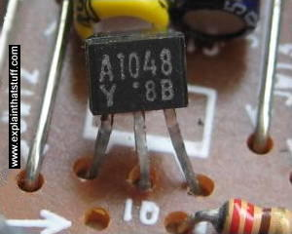
Transistors
Easily the most important components in computers, transistors can switch tiny electric currents on and off or amplify them.
Transistors that work as switches act as the memories in computers, while transistors working as amplifiers boost the volume of sounds in hearing aids.
When transistors are connected together, they make devices called logic gates that can carry out very basic forms of decision making.
* https://www.explainthatstuff.com/electronics.html, Chris Woodford,November 18, 2018
Notes:
Easily the most important components in computers, transistors can switch tiny electric currents on and off or amplify them (transform small electric currents into much larger ones). Transistors that work as switches act as the memories in computers, while transistors working as amplifiers boost the volume of sounds in hearing aids. When transistors are connected together, they make devices called logic gates that can carry out very basic forms of decision making. (Thyristors are a little bit like transistors, but work in a different way.)
Read more in our main article about transistors.
A FET transistor on a printed circuit board.
Photo: A typical field-effect transistor (FET) on an electronic circuit board.

Slide 12
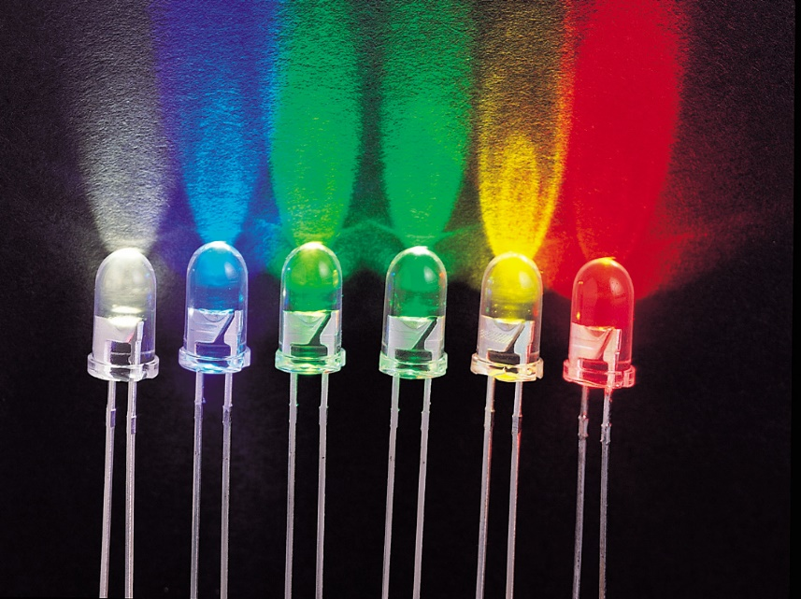
Opto-electronic (optical electronic) components
There are various components that can turn light into electricity or vice-versa.
photoelectric cells generate tiny electric currents when light falls on them and they're used as "magic eye" beams in various types of sensing equipment, including some kinds of smoke detector.
Light-emitting diodes (LEDs) work in the opposite way, converting small electric currents into light.
* https://www.explainthatstuff.com/electronics.html, Chris Woodford,November 18, 2018
Notes:
There are various components that can turn light into electricity or vice-versa. Photocells (also known as photoelectric cells) generate tiny electric currents when light falls on them and they're used as "magic eye" beams in various types of sensing equipment, including some kinds of smoke detector. Light-emitting diodes (LEDs) work in the opposite way, converting small electric currents into light. LEDs are typically used on the instrument panels of stereo equipment. Liquid crystal displays (LCDs), such as those used in flatscreen LCD televisions and laptop computers, are more sophisticated examples of opto-electronics.

Slide 13
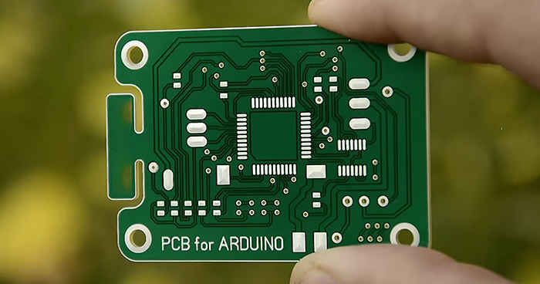
Electronic circuits
The key to an electronic device is how to they are arranged in circuits.
the easiest way to build a circuit is simply to connect components together with short lengths of copper cable.
But the more components you have to connect, the harder this becomes.
Components are then simply pushed through pre-drilled holes and fastened into place with a kind of electrically conducting adhesive known as solder.
A circuit manufactured in this way is known as a printed circuit board (PCB).
* https://www.explainthatstuff.com/electronics.html, Chris Woodford,November 18, 2018
Notes:
There are various components that can turn light into electricity or vice-versa. Photocells (also known as photoelectric cells) generate tiny electric currents when light falls on them and they're used as "magic eye" beams in various types of sensing equipment, including some kinds of smoke detector. Light-emitting diodes (LEDs) work in the opposite way, converting small electric currents into light. LEDs are typically used on the instrument panels of stereo equipment. Liquid crystal displays (LCDs), such as those used in flatscreen LCD televisions and laptop computers, are more sophisticated examples of opto-electronics.

Slide 14
02 Basic electrical quantities

Slide 15
electrical quantities
Current
Voltage
Resistance
Electrical Work
Electric power
* An introduction to electronics, The Open Universit, November 2018

Slide 16

Current(I)
Continuous movement of electrons through a conductor.
It is measured in Amperes (A)
He term ampere refers to the number of electrons passing to a given point in 1 second.
An ampere is the passage of 6.25 * 10818 electrons over a 1 second.
$$I=\frac{Q}{t}$$
Q=Electric charge(C)
t=time(s)
* An introduction to electronics, The Open Universit, November 2018

Slide 17

Voltage(V)
is electric pressure, a potential force or difference in electric charge between two points.
is measured in Volts.
$$V=R∗I$$
R= Electrical resistance
t= Electric current (A)
* An introduction to electronics, The Open Universit, November 2018

Slide 18

The Resistance(Ohm)
is the opposition to the flow of electrons or current
is measured in Ohms Ω
Then the factors which affect the resistance (R) of a conductor in ohms can be listed as:
The resistivity (ρ) of the material from which the conductor is made.
The total length (L) of the conductor.
The cross-sectional area (A) of the conductor.
The temperature of the conductor.
$$R=ρ. \frac{L}{A}$$
* An introduction to electronics, The Open Universit, November 2018

Slide 19



Ohm’s Law
Ohm's Law is a formula used to calculate the relationship between voltage, current and resistance in an electrical circuit
Ohm's law describes the way current flows through a resistance when a different electric potential (voltage) is applied at each end of the resistance.
This law is one of the most basic laws of electricity. It helps to calculate the power, efficiency, current, voltage, and resistance of an element of an electrical circuit.
$$R=\frac{V}{I}$$
$$I=\frac{V}{R}$$
$$V=R∗I$$
* An introduction to electronics, The Open Universit, November 2018

Slide 20
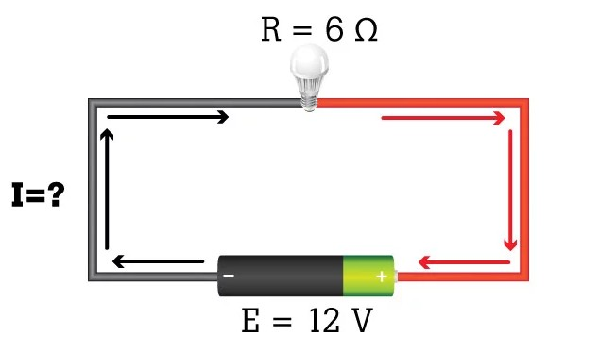
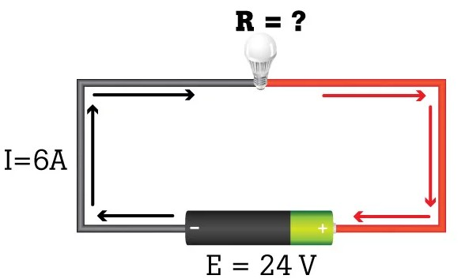
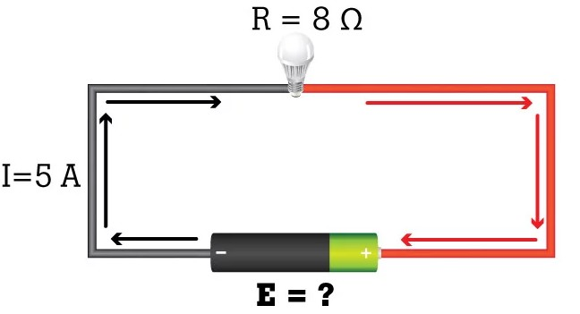






Example
$$I=\frac{V}{R}$$
$$I=\frac{12}{6}=2A$$
$$R=\frac{V}{I}$$
$$I=\frac{24}{6}=4Ω$$
$$V=R∗I$$
$$5∗8=40 V$$
* An introduction to electronics, The Open Universit, November 2018

Slide 21



Electrical Work (W)
Electrical work is done in moving q Coloumbs of charge from infinity to a point.
It is the same electrical energy.
Its unit is Joules (j) and watt hour (wh).
formula of electric energy
$$W=R.I^{2}.t$$
$$W=\frac{V^{2}}{R}.t$$
$$W=V.I.t$$
* An introduction to electronics, The Open Universit, November 2018

Slide 22




Power (p)
Is the amount of electric energy converted to another form of energy in a given length of time.
measured in Watts (W)
$$P=V.I$$
$$P=\frac{W}{t}$$
$$P=\frac{V^{2}}{R}$$
$$P=R.I^{2}$$
* An introduction to electronics, The Open Universit, November 2018

Slide 23
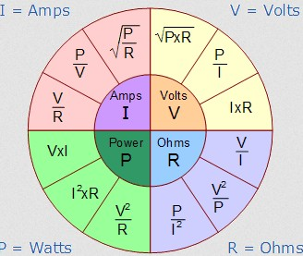
Relations between quantities
* An introduction to electronics, The Open Universit, November 2018

Slide 24
03 Analysis of Single-Board Computers for IoT

Slide 25
Single Board Computer
The Single Board Computer, SBC, is a complete computer built on a single circuit board.
The design is centered on a single microprocessor with RAM, input/output and all other features needed to be a functional computer on the one board.
Standard connectors are included on the CPU board unlike COM modules which typically need to be mounted on a baseboard with connectors to input/output peripherals
* Analysis of Single-Board Computers for IoT and IIoT Solutions in Embedded Control Systems, Pavlo Galkin, Lydmila Golovkina, Igor, 2018 International Scientific-Practical Conference, 2018

Slide 26
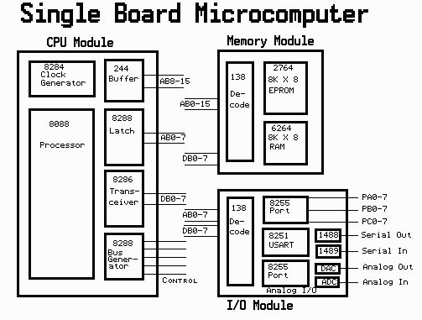
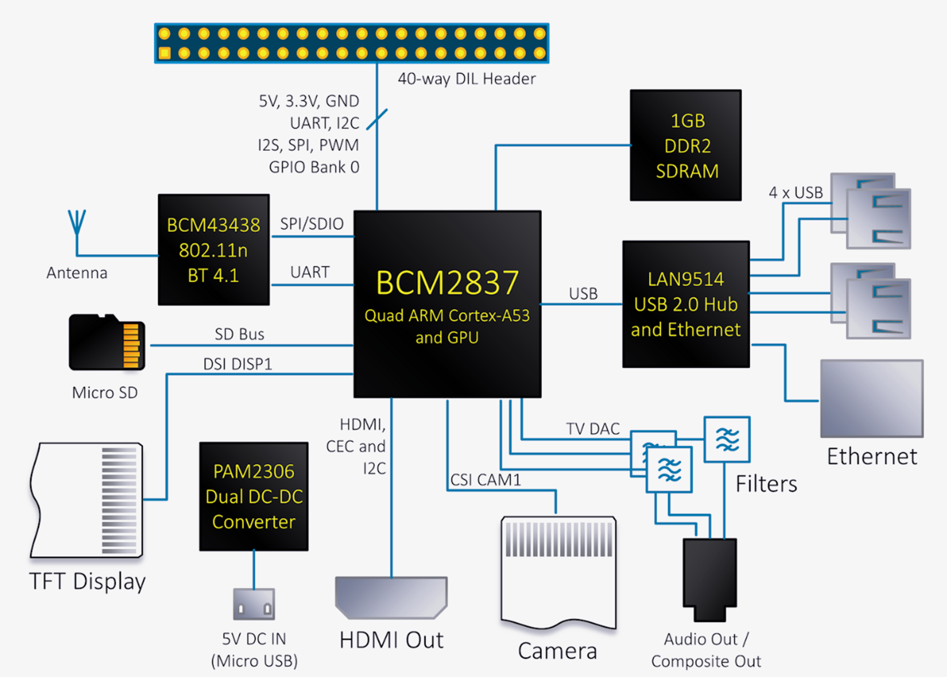
Single Board Computer
* http://www.cs.binghamton.edu/~reckert/sbc.htm

Slide 27
Choosing a Single Board Computer
Choosing the right single board computer (SBC) for an application requires many considerations.
Power
Choose an SBC that matches the power requirements for the specific application. As a complement to power, make sure the thermal management capabilities of the system are up to the task of cooling the chosen SBC for the system
Form Factor –
Important in any decision is the form factor of available SBCs. Form factors common in COTS embedded SBCs are: VME, VPX, CompactPCI and ComExpress. In the past 6U VME has been the most commonly used, but that is slowly changing to VPX, with increased interest in 3U for SWaP reasons.
* https://www.curtisswrightds.com/news/blog/choosing-a-single-board-computer.html

Slide 28
Choosing a Single Board Computer
Choosing the right single board computer (SBC) for an application requires many considerations.
Processor choice
The three primary choices seen in the embedded COTS market place are Intel, Power Architecture, and more recently ARM. Some of the considerations that follow will also influence processor choice.
Memory
With advancing technology, memory requirements have increased dramatically. And a gigabyte of memory was unheard of. Today many Intel processors offer 16 to 32 GB of memory. The memory demand of an application can influence the processor choice. For instance, compared to Intel, Power Architecture and ARM typically offer less memory and with that less powe.
* https://www.curtisswrightds.com/news/blog/choosing-a-single-board-computer.html

Slide 29
Choosing a Single Board Computer
Choosing the right single board computer (SBC) for an application requires many considerations.
Operating system
Operating systems many impact the processor and SBC choice due to availability on the chosen SBC. Typical OS-es available for embedded use are: Linux (of which there are many versions), INTEGRITY, GreenHills LynxOS, QNX, and Wind River VxWorks. A variety of processors support Linux.
I/O complement
For a particular application, an SBC must provide the right I/O complement in the right types and quantities, such as Ethernet, DIO, SATA, USB, serial ports (232, 422, 485) as well as board interconnect (VME, SRIO, PCIe, Ethernet). Related to this consideration is available support for add-on of a mezzanine card to expand on I/O not provided by the base SBC.
* https://www.curtisswrightds.com/news/blog/choosing-a-single-board-computer.html

Slide 30
Choosing a Single Board Computer
Choosing the right single board computer (SBC) for an application requires many considerations.
Performance
Application requirements vary vastly from low performance (and with that low power), to extremely high performance applications like SigInt with terrflops of processing requirements. Choose your processor wisely, as there's no need to pay for more performance and power than the application calls for.
* https://www.curtisswrightds.com/news/blog/choosing-a-single-board-computer.html

Slide 31
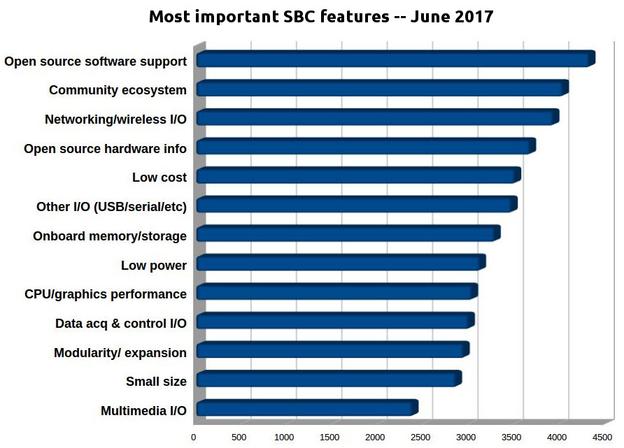
Choosing a Single Board Computer
* http://linuxgizmos.com/2017-hacker-board-survey-raspberry-pi-still-rules-but-x86-sbcs-make-gains/
Notes:
To earn a chance to win a prize, respondents needed to answer a few more questions beyond ranking. When asked about the key criteria for selecting a hacker SBC, our 1,705 respondents were very consistent with last year’s choices. High-quality open source software again led the list, followed by community ecosystem and networking and wireless I/O.
Open source hardware support ranked fourth, bumping memory and storage farther down the list. Other answers were also ranked much like last year, with standard I/O ports outranking media connections in priority.
Choices for intended applications were also very consistent with previous years. Home automation was again the clear winner, followed by education, which jumped from fourth to second place. This was followed by home multimedia and special function servers.
In a separate question about more general usage categories, the maker/hobbyist segment increased to 63 percent, and education rose to 9 percent. Those who considered themselves commercial developers dropped sharply from about 22 percent to 14 percent.

Slide 32
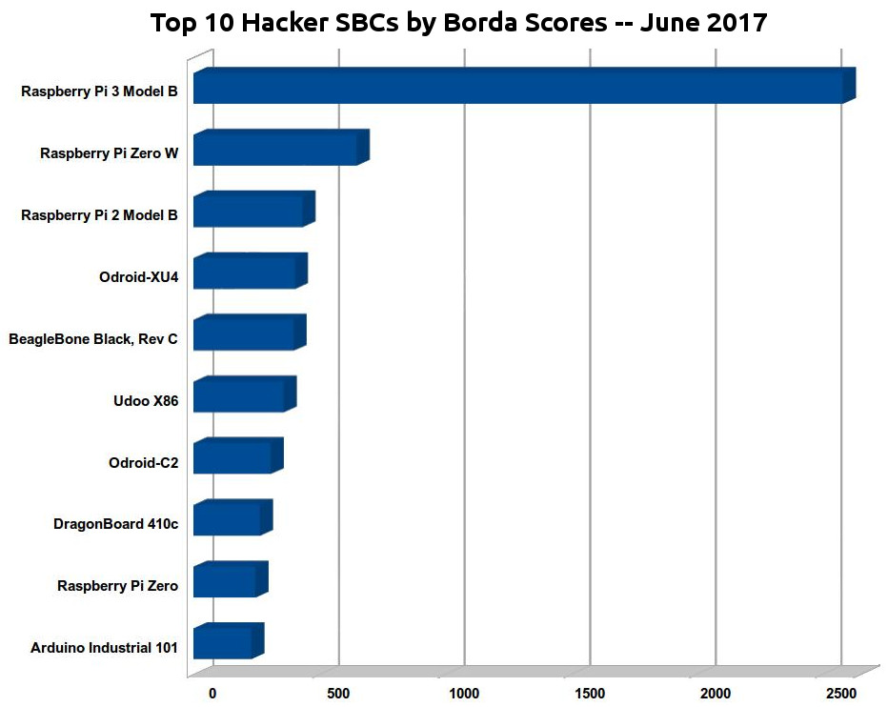
* http://linuxgizmos.com/2017-hacker-board-survey-raspberry-pi-still-rules-but-x86-sbcs-make-gains/
Notes:
he Raspberry Pi’s success came despite the fact that it offers some of the weakest open source hardware support in terms of open specifications. This, however, matches up with our survey responses about buying criteria, which ranks open source software support and community over open hardware support (see farther below). Note that by “votes” we are referring to Borda rankings that combine 1st, 2nd, and 3rd choice rankings (see the detailed list of votes here). Farther below, we also look at how the picture changes when looking only at respondents’ first choices. (Yes, the RPi 3 wins again, and by a 7-to-1 margin instead of 4-to-1.)
A Raspberry Pi SBC has won in all four of our annual surveys, but never by such a high margin. In our 2016 survey with 81 boards, the same RPi 3 out-scored the second-ranked Odroid-C2 by only 387 to 227, and in the 2015 vote with a choice of 53 SBCs, the top-ranked Raspberry Pi 2 beat the BeagleBone Black by 2,455 votes. Back in the 2014 survey, with 32 boards, the original Raspberry Pi Model B beat the BeagleBone Black by 1,136 to 814.
Not only did the Raspberry Pi boards run the table, but they appear to have slowed the momentum of dozens of pseudo clones that offer a Raspberry Pi like 40-pin expansion connector claimed to support RPi add-on boards. Only one 40-pin model from a third party — the Odroid-C2 — ranked in the top 10, and it fell from 2nd to 7th place. Fourth place after the Raspberry Pi models went to the Odroid-XU4, an octa-core Exynos based SBC, which lacks a Pi connector, but recently received a major price cut to $59.
Several RPi-compatible boards appeared in the top 20, and they performed well overall, but they were less dominating compared to last year. Respondents appeared to focus as much on the quality and scope of the community projects — and especially their software support — than on specific SBC models.
The Banana Pi pseudo clones — both from SinoVoip and LeMaker — outshone Shenzhen Xunlong’s Orange Pi boards, the most popular of which was the 28th ranked Orange Pi Zero. Yet the Orange Pi boards outshone FriendlyElec’s NanoPi boards, which scored a high with its similarly minimalist, dirt-cheap NanoPi Neo and Neo2, which together ranked 31st.
Both of these China-based vendors of Raspberry Pi compatible boards shared the highest number of entries, and we had to combine several similar boards to keep them within our 10 board per vendor limit. One reason the Orange Pi boards may have performed better than the NanoPi models is that shipping to the U.S. costs under $4 while the NanoPi starts at around $16, or twice the cost of the Neo itself.
The Orange Pi and NanoPi SBCs, which on paper are among the leaders in price/performance/feature attributes, performed surprisingly poorly. In part this may have to do with spotty software support. However, it could also be that they’re more popular in China than elsewhere, and China ranks only 17th among LinuxGizmos reader home countries, at about 1.4 percent. The survey participation was even lower: only eight respondents came from China, and three of those were from Hong Kong.

Slide 33
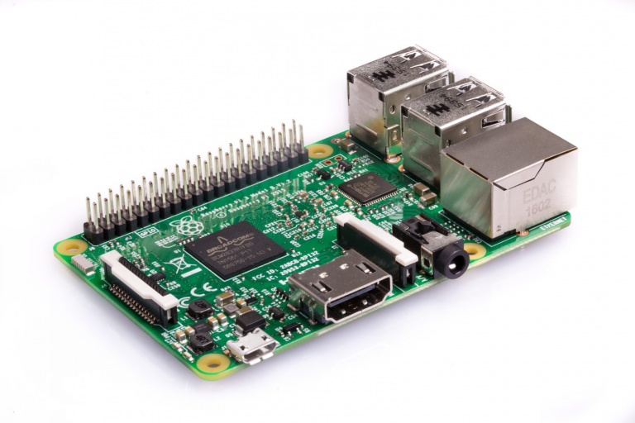
Raspberry Pi
The Raspberry Pi 3 from the Raspberry Pi Foundation is the world’s most popular and most compatible single board computer.
* https://www.curtisswrightds.com/news/blog/choosing-a-single-board-computer.html

Slide 34
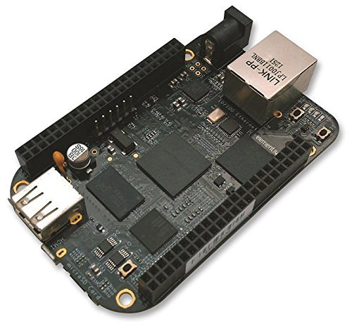
BeagleBone Black
Built on the proven BeagleBoard.or open source Linux approach, BeagleBone AI fills the gap between small SBCs and more powerful industrial computers.
* https://www.curtisswrightds.com/news/blog/choosing-a-single-board-computer.html

Slide 35
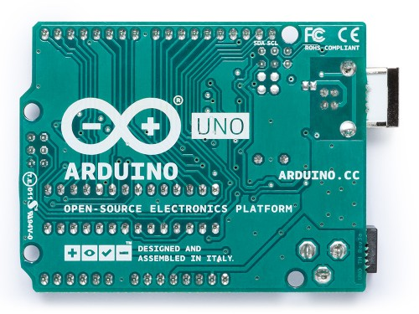
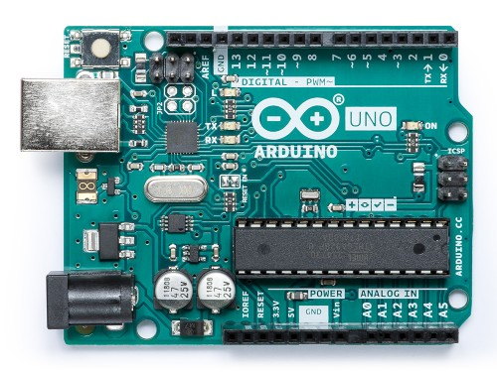
Arduino Uno Rev3
Built on the proven BeagleBoard.or open source Linux approach, BeagleBone AI fills the gap between small SBCs and more powerful industrial computers.
* https://www.curtisswrightds.com/news/blog/choosing-a-single-board-computer.html

Slide 36
Arduino Uno Rev3
Built on the proven BeagleBoard.or open source Linux approach, BeagleBone AI fills the gap between small SBCs and more powerful industrial computers.
Highlighted Features:
Microcontroller ATmega328P
Operating Voltage 5V
Digital I/O Pins 14 (of which 6 provide PWM output)
20mA DC current per I/O pin
Powered via USB connection or with external power
* https://www.curtisswrightds.com/news/blog/choosing-a-single-board-computer.html

Slide 37
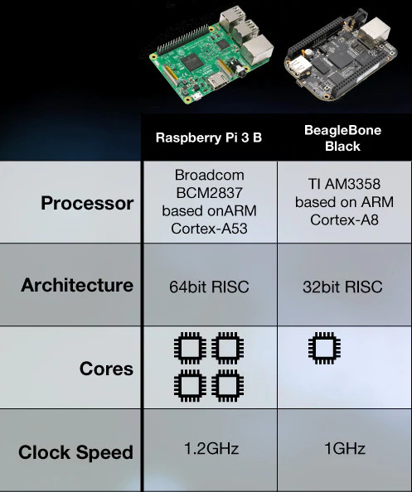
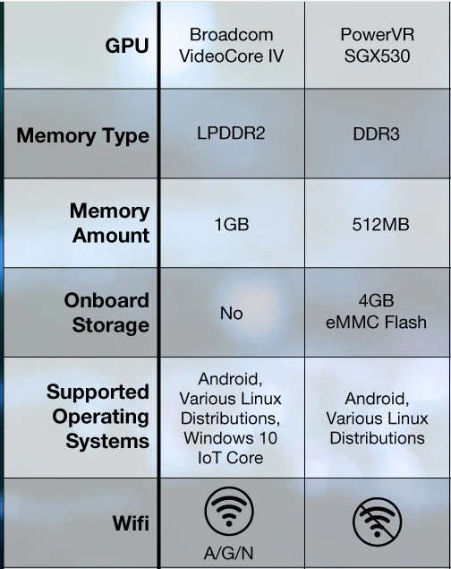
Highlighted Features:
Microcontroller ATmega328P
Operating Voltage 5V
Digital I/O Pins 14 (of which 6 provide PWM output)
20mA DC current per I/O pin
Powered via USB connection or with external power
* https://www.curtisswrightds.com/news/blog/choosing-a-single-board-computer.html

Slide 38
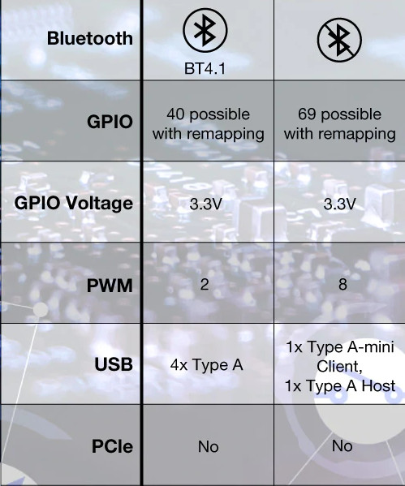
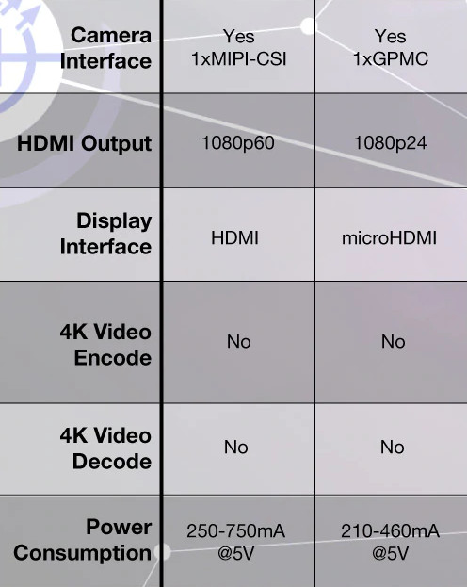
Highlighted Features:
Microcontroller ATmega328P
Operating Voltage 5V
Digital I/O Pins 14 (of which 6 provide PWM output)
20mA DC current per I/O pin
Powered via USB connection or with external power
* https://www.curtisswrightds.com/news/blog/choosing-a-single-board-computer.html

Slide 39
SBC in IoT
IoT boards, also known as development boards or prototyping boards, are basically hardware platforms that are commonly used to build prototypes of manufacturer’s ideas.
SBCs are also increasingly used for a wide range of industrial applications in areas that include robotics and the Internet of things (IoT).
Such systems are implemented with using low cost, single board computers with embedded Linux like Raspberry Pi (RPI)
* Analysis of Single-Board Computers for IoT and IIoT Solutions in Embedded Control Systems, Pavlo Galkin, Lydmila Golovkina, Igor, 2018 International Scientific-Practical Conference, 2018

Slide 40
04 Background on wireless PHY layer

Slide 41
Radio
signal carried in electromagnetic spectrum
propagation environment effects:
reflection
obstruction by objects
interference

Slide 42
Frequncies Range
Frequency | Wavelength | Designation | Abbreviation
3 - 30 Hz | 10^5km-10^4km | Extremely low frequency | ELF
30 - 300 Hz | 10^4km-10^3km | Super low frequency | SLF
300 - 3000 Hz | 10^3km-100km | Ultra low frequency | ULF
3 - 30 kHz | 100km-10km | Very low frequency | VLF
30 - 300 kHz | 10km-1km | Low frequency | LF
300 kHz - 3 MHz | 1km-100m | Medium frequency | MF
3 - 30 MHz | 100m-10m | High frequency | HF
30 - 300 MHz | 10m-1m | Very high frequency | VHF
300 MHz - 3 GHz | 1m-10cm | Ultra high frequency | UHF
3 - 30 GHz | 10cm-1cm | Super high frequency | SHF
30 - 300 GHz | 1cm-1mm | Extremely high frequency | EHF

Slide 43
General Frequency Ranges
Radio frequency range
30 MHz to 30 GHz
Suitable for omnidirectional applications
Infrared frequency range
Roughly, 3x1011 to 2x1014 Hz
Useful in local point-to-point multipoint applications within confined areas

Slide 44
Spectrum Allocation for Existing Systems*
Required antenna size for good reception is inversely proportional to the signal frequency
so moving to a higher frequency allows for more compact antennas
Received signal power with nondirectional antennas is proportional to the inverse of frequency squared.
So it’s hard to cover large distances with higher frequency signals (with nondirectional antennas)
*Adopted from Wireless Communication by Goldsmith (Chapter2)

Slide 45
Spectrum Allocation for Existing Systems*
Most wireless applications reside in radio frequency between 30MHz to 30 GHz (VHF,UHF and SHF)
Why these frequencies?
They are not affected by earth curvature
Require only moderated size antennas
Can propagate ionosphere
*Adopted from Wireless Communication by Goldsmith (Chapter2)

Slide 46
Signals
physical representation of data
function of time and location
signal parameters: parameters representing the value of data
classification
continuous time/discrete time
continuous values/discrete values
analog signal = continuous time and continuous values
digital signal = discrete time and discrete values
signal parameters of periodic signals: period T, frequency f=1/T, amplitude A, phase shift φ sine wave as special periodic signal for a carrier:
s(t) = A_{t} sin(2 π f_{t} t + ϕ_{t})

Slide 47
Signals
Different representations of signals
amplitude (amplitude domain)
frequency spectrum (frequency domain)
phase state diagram (amplitude M and phase φ in polar coordinates)
A [V]
A [V]
Q = M sin ϕ
t[s]
ϕ
I= M cos ϕ
ϕ
f [Hz]
Composed signals transferred into frequency domain using Fourier transformation
Digital signals need
infinite frequencies for perfect transmission
modulation with a carrier frequency for transmission (analog signal!)

Slide 48
Signal Propagation Ranges
Transmission range
communication possibale
low error rate
Detection range
detection of the signal possible
no communication possible
Interference range
signal may not be detected
signal adds to the background noise
sender
transmission
distance
detection
interference

Slide 49
Signal Propagation Ranges
Propagation in free space always like light (straight line, line of sight)
Receiving power proportional to
1 / (d×f)² (ideal)
1/(d×f)α (α=3...4 realistically)
d = distance between sender and receiver
Receiving power additionally influenced by
fading (frequency dependent)
shadowing
reflection at large obstacles
scattering at small obstacles
diffraction at edges
shadowing
reflection
scattering
diffraction

Slide 50
Multipath propagation
Time dispersion: signal is dispersed over time
interference with “neighbor” symbols, Inter Symbol Interference (ISI)
The signal reaches a receiver directly and phase shifted
distorted signal depending on the phases of the different parts
signal at sender
signal at receiver

Slide 51
Transceiver Structure: Communications Block Diagram
Information
Source
Source
Encoder
Channel
Encoder
Modulator
Channel
(Physical Media)
Noise
Information
Destination
Source
Decoder
Channel
Decoder
Demodulator

Slide 52
Transceiver Structure: Communications Block Diagram
Digital modulation
Digital data is translated into an analog signal (baseband) ASK, FSK, PSK
Differences in spectral efficiency, power efficiency, robustness
Analog modulation
Shifts center frequency of baseband signal up to the radio carrier
Motivation
Smaller antennas (e.g., λ/4)
Frequency Division Multiplexing
Medium characteristics
1
0
1
t
1
0
1
t
1
0
1
t

Slide 53
04 System design (under power viewpoint)

Slide 54
System design
Many factors must be considered in the design of Wireless systems:
Power of transmitting device
Loss and gain of connectivity devices (cables, connectors, attenuators, amplifiers, splitters) between transmission device and transmitter’s antenna
Power of the intentional radiator (last connector just before antenna)
Power radiated by antenna element (EIRP)
Propagation properties of the medium (attenuation before signal reception)
Loss and gain of connectivity devices (cables, connectors, attenuators, amplifiers, splitters) between receiver’s antenna and receiver device.

Slide 55
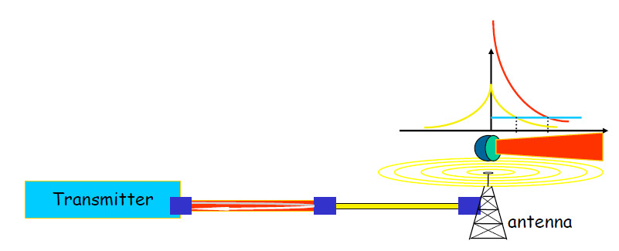
System design

Slide 56
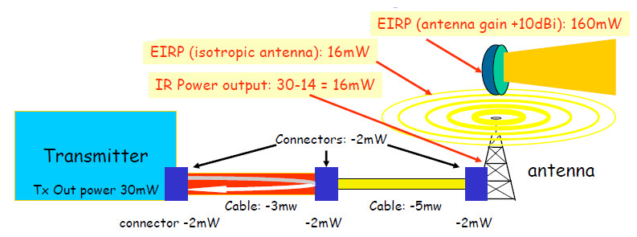
Intentional radiator and EIRP
(Intentional) radiator: (def.) RF device specifically designed to generate and radiate RF signals.
...Includes Tx RF device, cables and connectors (antenna excluded)
IR Power output: (subject to regulations) is the power output of last connector just before the antenna
Equivalent Isotropically Radiated Power (EIRP): the power radiated by the antenna (including the passive antenna gain effect of directional antennas)

Slide 57
Power measurement
WATT: electric power unit
1 Watt = 1 Ampere * 1 Volt (P=V*I) also P= R*I^2 and P = L/t
Current (ampere) is the amount of charge (electrons) flowing as current in a wire
Voltage (Volt) is the “pressure” applied to the flow of charge
Resistance (impedance) is the obstacle to current flow
Power is the energy needed (in a given time unit) to apply a given “pressure” to a given “amount of charge”, by resulting in a flow of current.
Watt and dBm are units used for absolute power measurement
Typical RF power for WLANs:
AP: 30..100 mW (up to 250 mW outdoor), PCMCIA: 15..30 mW

Slide 58
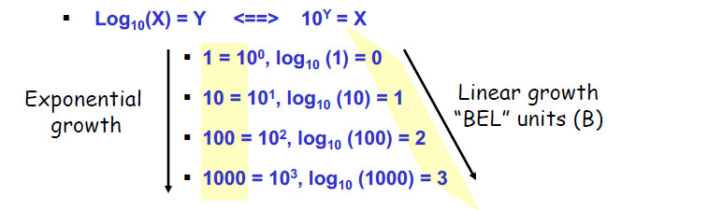
Power measurement
Decibel (dB): a power measurement unit designed to express power loss
It is more practical to use given the logarithmic decay of wireless signals
It allows to make easy calculations on “resulting power”
Decibel (dB) measures the logarithmic relative strength between two signals (mW are a linear absolute measure a energy)
How strong is a 10 dB signal? (it depends on the reference signal)

Slide 59
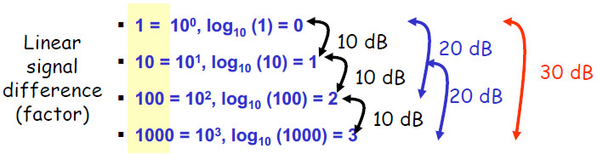
Power measurement
Decibel (dB): 1/10 of a Bel
E.g. 1000 is one Bel greater than 100 => 1000 is 10 dB greater than 100
How strong is a 10 dB signal? (it depends on the reference signal)
Positive dB value is power gain, negative dB value is power loss
e.g. given 7 mW power, a +10 dB signal gain is 70 mW
e.g. given 7 mW power, a -10 dB signal gain (loss) is 0.7 mW
Power Difference (in dB) between Tx and Rx signal:
Power Difference (dB) = 10 * log(Power Rx(Watt) / Power Tx (Watt))
Gain and Loss are relative power measurements: dB is the unit

Slide 60
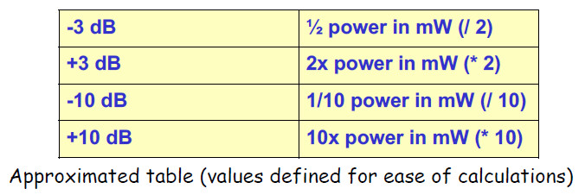
Power measurement
Advantage of dB: what is better?
E.g.: A signal transmitted at [TX] 100 mW is received at [RX] 0.000005 mW
Power Difference (dB) = 10 * log([RX] /[TX]) = 10 * log(0.000005mW/100mW) = -73
A signal transmitted at 100 mW is received with gain (loss) –73 dB
Advantage of dB: what is better?
E.g.: A signal transmitted at 100 mW is received at 0.000005 mW, then it is amplified (*100) to 0.0005 mW ….. ???
A signal transmitted at 100 mW is received with gain (loss) -73+20= -53 dB

Slide 61
Power measurement
dBm: dB-milliWatt, the absolute measure of signal power
Assumption: reference signal is 1 mW = 0 dBm(normalization factor)
Useful for gain/loss calculation without passing through mW
E.g. access point transmits 100 mW = 1mW (*10*10) =+20 dBm
PCMCIA card transmits at 30 mW = 1mW (*10*3) = +14.7 dBm
E.g. Tx= 30 mW, cable –2 dB, amplifier +9 dB:
30 mW = 1mW *10 *3 = 14.7 dBm
IR power : 14.7 dBm –2dB +9dB = 21.7 dBm (147.91 mW)
In general, for converting mW to dBm and viceversa:
P_{dBm} = 10 log(P_{mW}) and P_{mW} = 10 ^{(PdBm /10)}

Slide 62
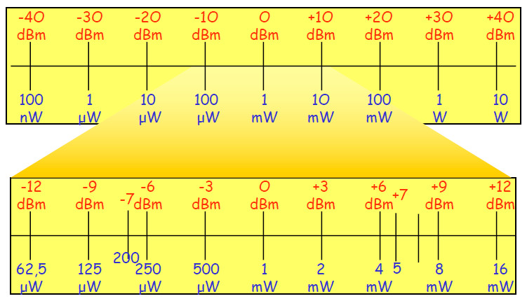
mW - dBm: conversion table

Slide 63
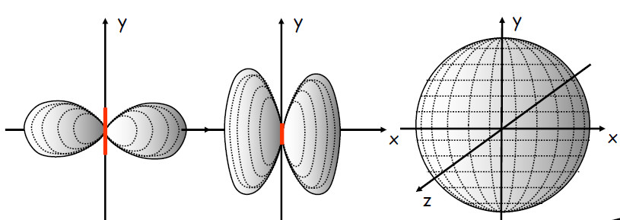
Power measurement
dBi: dB-isotropic, the normalized measure of antenna passive gain
Assumption: an isotropic radiator has 100% efficiency in radiating
energy in uniform way in every direction (e.g. the Sun)
Antennas concentrate energy in non-isotropic way, resulting in
passive gain (space dependent). Ideal antenna: zero length dipole

Slide 64
Antennas
Illustration of general issues
Convert electrical energy in RF waves (transmission), and RF waves in electrical energy (reception)
Size of antenna is related to RF frequency of transmission and reception
Shape (structure) of the antenna is related to RF radiation pattern
Radiation patterns of different antenna types
Positioning antennas
Maximum coverage of workspace
Security issues
Real antenna types: omni-directional, semi-directional, highly-directional

Slide 65
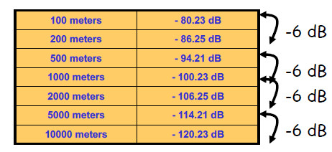
Path Loss
Path Loss: RF signal “dispersion” (attenuation) as a function of distance
E.g. Possible formulas (36.6 or 32.4)
Free space: Loss (in dB) = 36.6+(20*log10(F))+(20*log10(D))
F (Mhz), D (miles)
Link budget issue: 6 dB rule
Each 6 dB increase in EIRP (signal x 4) implies double Tx range (e.g. see table below: 2.4Ghz Path Loss vs distance)

Slide 66
Link Budget Calculation
“Link Budget” or “System Operating Margin”
Excess of signal between transmitter and receiver
Calculated for outdoor point-to-point connections
Measured in dB (relative) or dBm or mW (absolute)
Calculation:
Receiver sensitivity RS (weakest detectable signal)
The lower the better: e.g. IEEE 802.11 card (see device manual), -95 dBm (1Mbps), -93 dBm (2 Mbps), -90 dBm (5.5 Mbps), -87 dBm (11 Mbps)
Link Budget: received power (in dBm) - RS (in dBm)
E.g. RS = -82 dBm, received power = -50 dBm
Link budget = -50 – (-82) = +32 dBm
This means the signal has margin of +32 dB before it becomes unviable
Fade margin: extra margin for link budget (to cope with multipath variation in indoor/outdoor scenarios): typical [+10..+20] dB

Slide 67
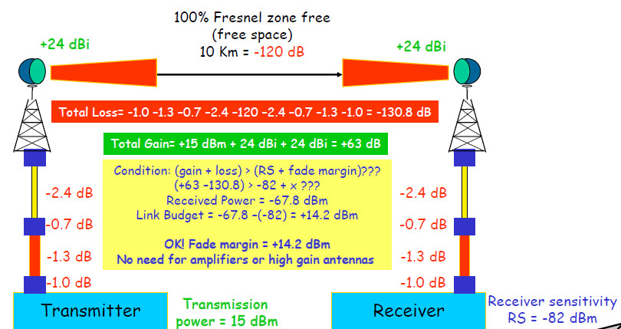
Link Budget Calculation: example

